Slide 1
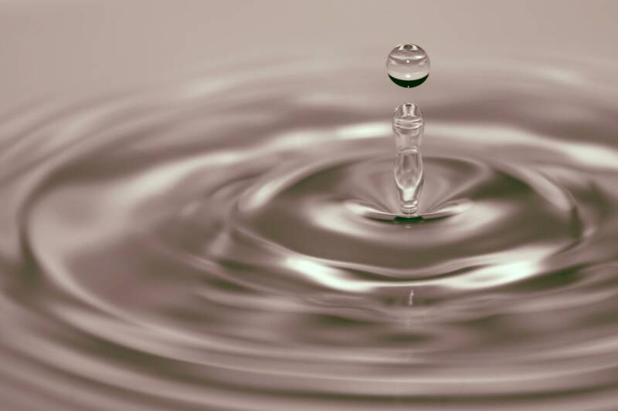
Waves

Slide 2
What is a wave?
Wave = is a disturbance that travels through a medium or space (vacuum) from one
location to another.
Waves transfer only energy not matter because matter always returns to its rest position (equilibrium)
Let’s do the wave!!!

Slide 3
Wave Classification
Mechanical Waves
Require a medium
Medium = any form of matter or substance through which waves pass.
Ex: air, water
Ex: sound
Speed depends medium
Electromagnetic Waves
No medium is needed;
Travel through a vacuum (= empty space)
Ex: light, radio, x-rays, gamma rays
Travel at the speed of light:
3.0 x 10⁸ m/s

Slide 4
Types of Waves
Longitudinal (Compression):
The disturbance of the particles of the medium is parallel (║) to the direction of wave propagation. 1-dimensional
Transverse:
The disturbance of the particles of the medium is perpendicular (┴) to the direction of wave propagation. 2-dimensional

Slide 5
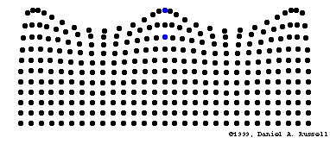
Types of Waves
Circular waves = particles of a medium move in a circular fashion to the direction of wave propagation.
Ex. water waves at the surface.

Slide 6
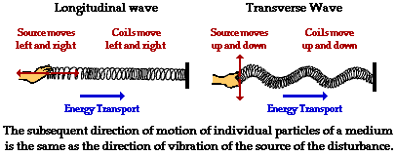

Slide 7
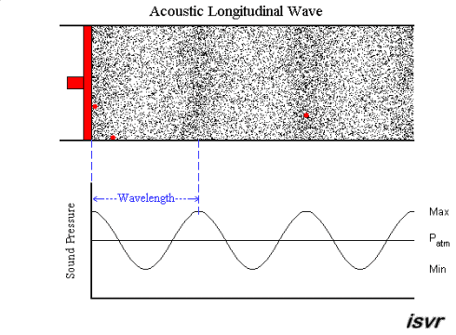

Slide 8
Anatomy of a Transverse Wave
CRESTS
The points A and F are called the CRESTS of the wave.
This is the point where the wave exhibits maximum amount of positive or upwards displacement.

Slide 9
Anatomy of a Wave
TROUGHS
The points D and I are called the TROUGHS of the wave.
These are the points where the wave exhibits maximum amount of negative or downward displacement.

Slide 10
Anatomy of a Transverse Wave
5
(m)
0
-5
In our wave here the dashed line represents the equilibrium (rest position of particles not displaces up or down).
Arrows indicate AMPLITUDE (A) a.k.a wave height. These are areas where the particle exhibits maximum positive, up (+) and negative, down (-) displacement from the equilibrium.
Amplitude (A) = ½ (crest – trough)
= ½ (5 m – (-5 m)) = 5 m

Slide 11
Anatomy of a Transverse Wave
A complete WAVELENGTH (λ) can be from crest to crest (points A trough F), trough to trough (points D through I) or from any point on the wave to the next place where that point occurs (points B through G). Measured in units of length.
This is the length of a cycle.

Slide 12
Anatomy of a Longitudinal Wave
A
B
C
D
Compression = areas of high pressure
Rarefaction = areas of low pressure
A complete WAVELENGTH (λ) can be from compression to compression (points A trough C) or rarefaction to rarefaction (points B through D). Measured in units of length.
This is the length of a cycle.

Slide 13
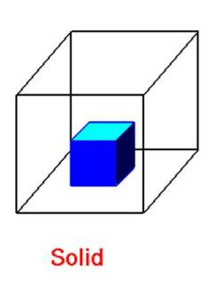
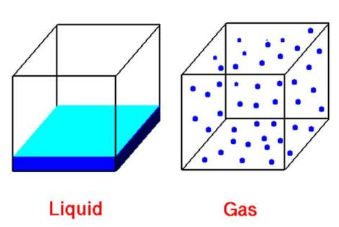
Mediums-Which Type of Waves?
Waves traveling through a
solid medium can either
be transverse or
longitudinal.
Waves traveling through
the bulk of a fluid (such as
liquid/gas) are always
longitudinal.

Slide 14
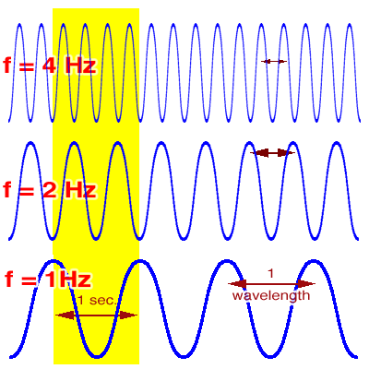
Frequency, f
“How often something happens.” Is the number of wave cycles (wavelength) that passes a given point per second. Measured in number of cycles/time. Units are in Hertz (Hz = 1/s).

Slide 15
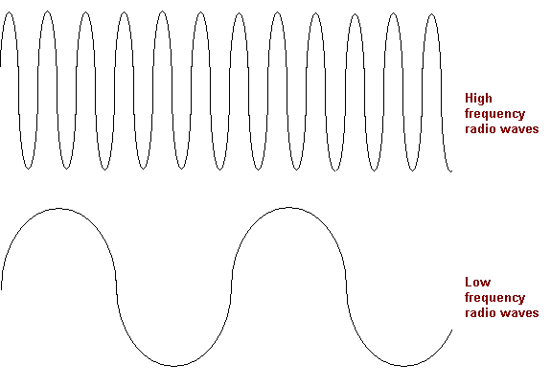
Longer wavelength, low frequency; low energy
Shorter wavelength, high frequency: high energy

Slide 16
Frequency School Day Example: “How often something happens.”
There are 9 periods in a school day.
*school day = 405 minutes
f = cycles/time
= 9 periods/405 min
= 0.02 periods per min

Slide 17
Frequency Formula:
f = cycles or 1
time T
Period
(s)
Frequency
(Hz = 1/s)

Slide 18
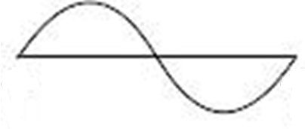
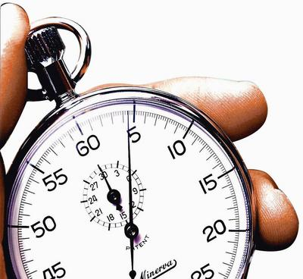
Period, T
“The amount of time it takes for something to
happen”; the time required to complete one wave cycle
(wavelength). Measured in time/number of cycles.
Units in seconds (s).

Slide 19
Period School Day Example: “The amount of time it takes for something to happen.”
There are 9 periods in a school day.
*school day = 405 minutes
T = time/cycles
= 405 min/9 periods
= 45 min per period

Slide 20
Period Formula:
T = _time_ or 1
cycles f
frequency
(Hz = 1/s)
Period (s)

Slide 21
Frequency and Period are Related. f T
Frequency and Period are reciprocals of each other.
f = 1 T = 1
T f

Slide 22
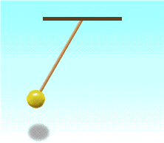
Harmonic Motion of a Pendulum Repetitive movement back and forth through an equilibrium.
Back & forth = 1 cycle

Slide 23
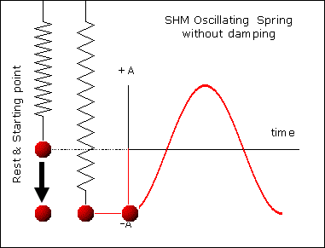
Harmonic Motion of a Spring Repetitive movement back and forth through an equilibrium.

Slide 24
Example Problems
A pendulum completes 32 cycles in 16 seconds (s). What
is the frequency? What is the period?
f = cycles or 1
time T
T = time or 1
cycles f
f = 32 cycles or 1
16 s 0.5 s
T = 16 s or 1
32 cycles 2/s
= 2 Hz
f = 2/s
T = 0.5 s

Slide 25
Quiz #6
Using a sheet of graphing paper, draw a harmonic motion graph of a pendulum with an amplitude of 5 m and a period of 2 seconds. Be sure to title your graph Position vs. Time and properly label the y and x axis with the appropriate titles and units.

Slide 26
How fast does a wave travel?
We can use what we know to determine how fast a wave is moving.
What is the formula for velocity?
Velocity (v) = distance (d)/time (t)
What distance (d) do we know about a wave?
Wavelength (λ)
What time do we know?
Period (T) = 1/f
The velocity of a wave depends on the properties of the medium through which it is traveling.

Slide 27
v
λ
f

Slide 28
Velocity of a Wave Formula:
v = (λ)(f)
wavelength
(m)
frequency
(Hz = 1(cycles)/s)
Velocity (m/s)

Slide 29
v = λ ∙ f
v = λ ∙ 1 = λ
T T

Slide 30
Example Problem #2
A water ripple is being sent across a pool of water by a
boat that is rocking at a rate of 1.5 Hz. The wave ripples
are measured to be 2 meters (m) apart. How fast are
they moving?
*1.5 Hz 1/s
1 Hz
= 1.5/s
v = λ x f
= 2 m x 1.5/s
= 3 m/s

Slide 31
Example Problem #3
The speed of sound varies depending on temperature,
pressure, and humidity, but can often be around 330 m/s.
What is the frequency of a sound wave with a wavelength
of 2 meters (m)?
v = λ x f → f = v
λ
= 330 m/s
2 m
= 165/s 1 Hz
1/s
= 165 Hz

Slide 32
Example Problem #4
Waves are being sent through a slinky at a frequency of
1.5 Hz. If the waves are traveling through the slinky at
3 m/s, what are their wavelengths?
*1.5 Hz 1/s
1 Hz
= 1.5/s
v = λ x f → λ = v
f
= 3 m/s
1.5/s
= 2 m

Slide 33
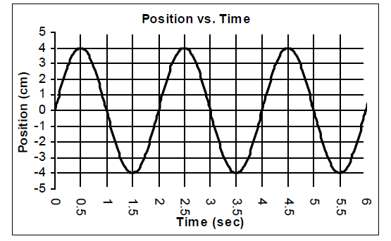
Example problem # 5 Determine the T, f and v of this wave is the λ = 5 m
(m)

Slide 34
Example Problem # 5 Determine the T, f and v of this wave is the λ = 5 m
How to find the period (T)?
Pick a point (whether from equilibrium, crest or trough), determine the time it takes to complete one cycle.
T = 2 s
(m)
T = 2.5 s – 0.5 s = 2 s
T = 3.5 s – 1.5 s = 2 s

Slide 35
Example Problem # 5 Determine the T, f and v of this wave is the λ = 5 m
How to find the frequency (f)?
From previous problem…T = 2 s
Frequency is the number of cycles that pass per second.
f = 0.5 cycles/s = 0.5 Hz
(m)
Or you can use the frequency formula:
f = 1/T
f = 1/2 s = 0.5 Hz

Slide 36
Example Problem # 5 Determine the T, f and v of this wave is the λ = 5 m
From previous problem…T = 2 s
f = 0.5 Hz
How to find the velocity (f)?
Use the velocity of a wave formula:
v = λ x f
= (5 m)(0.5/s)
= 2.5 m/s
(m)
Or if you are given the period instead of frequency:
v = λ x f
v = λ x (1/T) = λ/T
v = (5 m)/(2 s)
v = 2.5 s

Slide 37
How do waves behave?
Now we know all about waves.
How to describe them, measure them and analyze them.
We know that waves travel through mediums.
But what happens when that medium runs out?

Slide 38
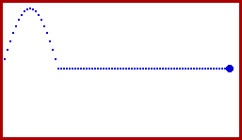
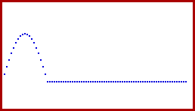
Reflection = the turning back of a wave when
it reaches the boundary of the
medium through which it is traveling.
FIXED END FREE END

Slide 39
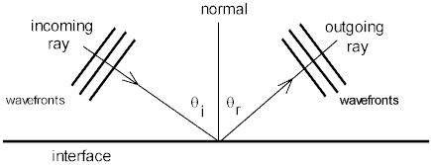
Law of Reflection = the angle of incidence is equal to the angle of reflection.

Slide 40
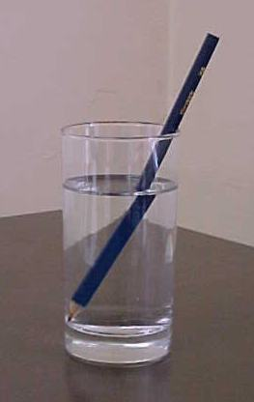
Refraction = the bending of a wave as it passes obliquely from one medium into another of different propagation speed.
Air
Water

Slide 41
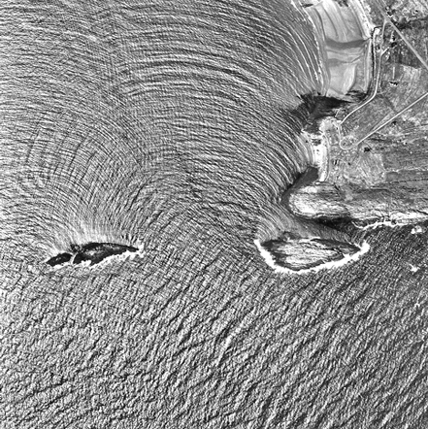
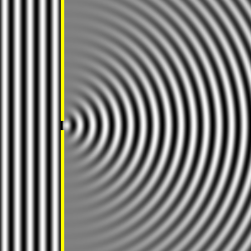
Diffraction = the spreading of a wave
around a barrier or
through an opening.

Slide 42
How do waves interact with another waves?
Interference = when two waves meet while
traveling along the same medium.
Superposition Principle = when interference occurs the resultant wave is the sum of the displacements of the individual waves at each point.
What happens when two waves meet?
Will they become friends or enemies?

Slide 43
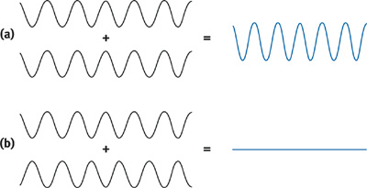
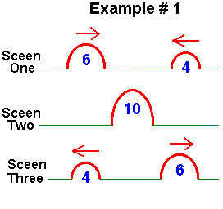
Constructive
interference (friends) = two waves match up: crest with crest or trough with trough (in phase = (both above or both below equilibrium) will produce a greater amplitude.
Before
During
After

Slide 44
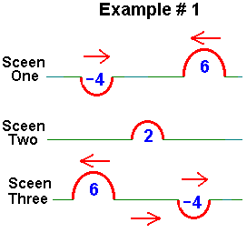
Destructive
interference (enemies) = two waves don’t match up: crest with trough (out of phase = one above and one below equilibrium) will result in a smaller (different amplitudes) or complete cancelation (same amplitude) of amplitude.
Before
During
After

Slide 45
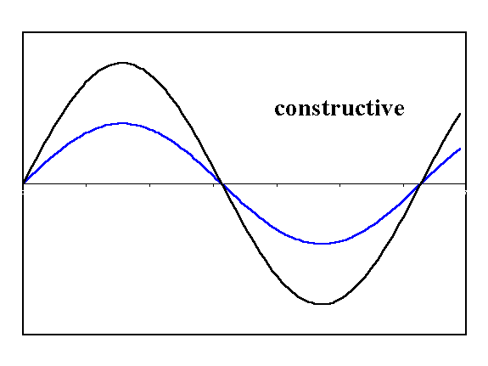

Slide 46
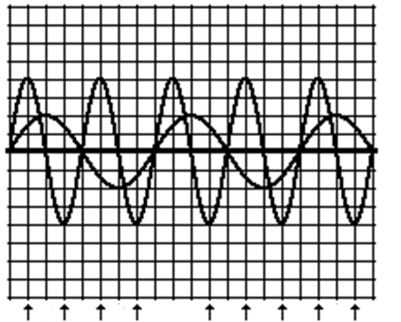
Check Your Understanding
Which points will produce constructive interference and
which will produce destructive interference?
Constructive interference
A, D, G, H
Destructive interference
B, C, E, F, I
A B C D E F G H I

Slide 48
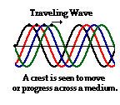
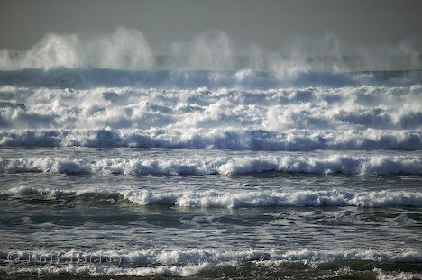
Traveling waves are waves that continue to move in a
uninterrupted fashion until it encounters another wave
along a medium or until it encounters a boundary with
another medium.
ex: ocean waves

Slide 49
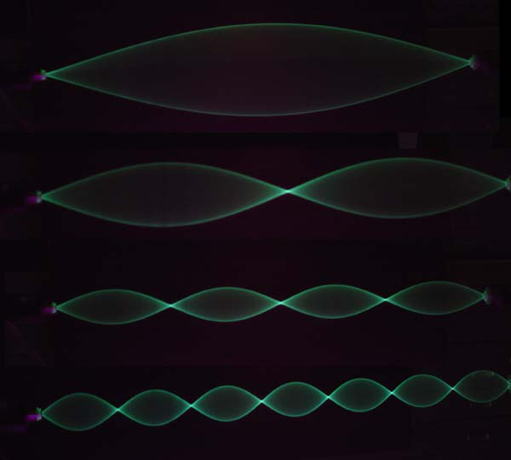
Standing waves = wave pattern characterized by points that appear to be still with points of no displacements (amplitudes). Produced by fixed end reflection.
Have harmonic frequencies.
Have nodes (no displacements) and
antinodes (displacements).

Slide 50
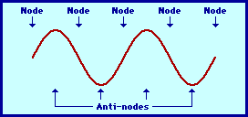
Nodes (N) = are produced at locations where destructive interference occurs.
Antinodes (AN) = are produced at locations where constructive interference occurs

Slide 51
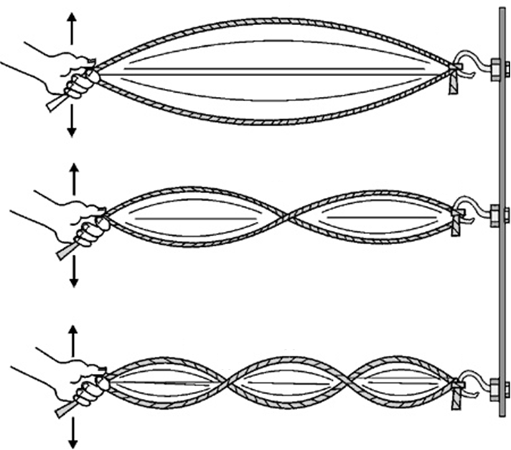
AN
N
N
AN
AN
N
N
N
AN
AN
AN
N
N
N
N

Slide 52
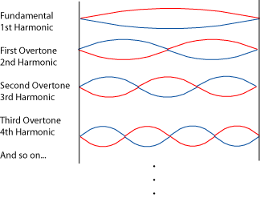
Harmonics = Repetitive movement back and forth through an equilibrium. Each frequency associated with a different standing wave pattern.
2 N, 1 AN
3 N, 2 AN
4 N, 3 AN
5 N, 4 AN

Slide 53
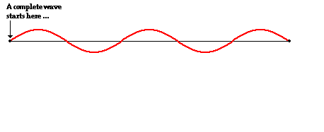
*1 complete standing wave consists of 2 loops,
then each loop’s length (L_{L}) is equaled to
½ a λ (wavelength). “L” = length of the entire
string.

Slide 54
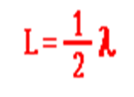
4th Harmonic
(n)th Harmonic
4
n
8

